Slide 1

Subscribe in August:
Xamarin Indie only $25 a month!
Xamarin Studio
iOS & Android Development in C#
Xamarin.Forms
So Much More!
store.xamarin.com
Notes:
*Limited time through the month of August.
Details at store.xamarin.com.
Per platform per year.

Slide 2

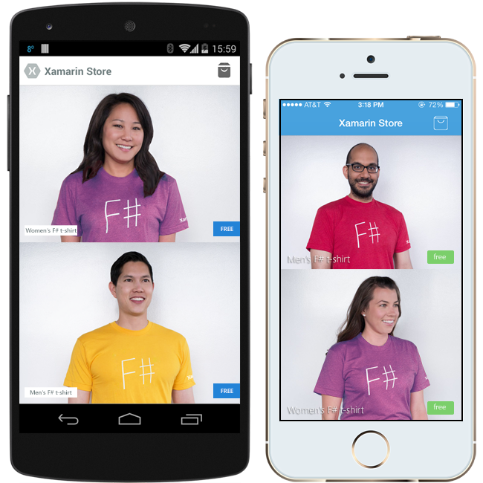

Get your FREE C# or F# shirt today!
xamarin.com/shirt
Notes:
Pick your size, your color. Shipped for free to your door around the world!

Slide 3

Dive Deep into Mobile Development with the Experts!
xamarin.com/evolve

